Slide 1
Toxic online posting message detection
นายกิติธัช ปานสังข์ 6310412003
นายกอฟฟาร์ ลัดเลีย 6310412019
นายธีธัช นาคเสนีย์ 6310412021

Slide 2
Problem
With the rise of social media in Thailand, online toxicity is becoming not only more severe, but also more difficult to control. Many people later come to regret their negative posts as a result of problems they face, such as being fired from their jobs and losing other opportunities. Bullying and other forms of toxic behavior are difficult to remove once they have been made public. As a result, we investigated these issues in order to improve the quality of online conversion by identifying a method to distinguish hate speech from online-posting messages.

Slide 3
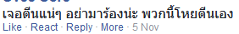
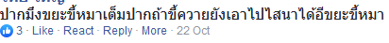
Toxic speech
Toxic speech inflicts individual and group harm, damaging the social fabric upon which we all depend. From sarcastic comments from the people around us to online bullying to the latest crisis in the news, so many messages we hear are toxic and hurtful.

Slide 4
Scope of study
The scope of work involves the detection of hate messages in direct communication between interlocutors on online media, both in the form of conversations. and expressing opinions and introducing measures to prevent negative communication by identifying toxic message to classify, then, make it more rightfully, such as reporting it to the platform administrator.
Developing the classification model to be capable of distinguish toxic or non-toxic from the real dataset scraping from social media, for instance, Youtube, Twitter.

Slide 5
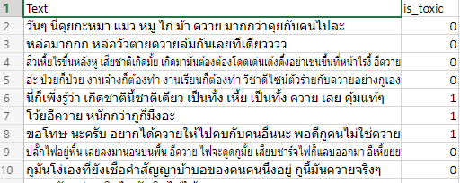
Dataset
Data from Existing Research Sources Sirihattasak S., Komachi M., Ishikawa H. (2017) Annotation and Classification of Toxicity for Thai Twitter (2160 data)
source : https://huggingface.co/datasets/thai_toxicity_tweet
paper : https://www.ta-cos.org/sites/ta-cos.org/files/1_W32.pdf
Data from twitter in a package called snscrape (1325 data)
Data from youtube using selenium tool to import dataset (953 data)

Slide 6
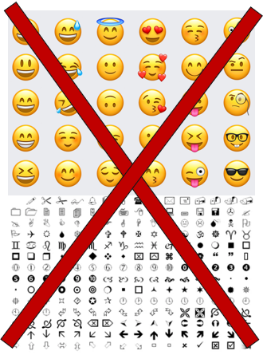
Cleansing data
Non-alphabet
Emoji
Emoticon
Number
Non-Thai language

Slide 7
Word2Vec + LSTM

Slide 8
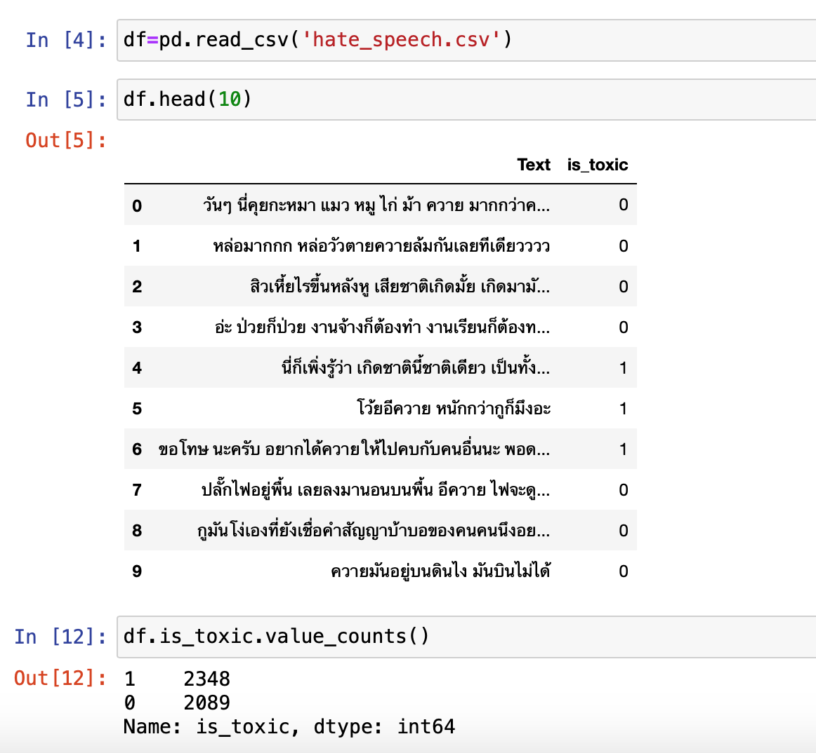
Handle Data
Model
Evaluate

Slide 9
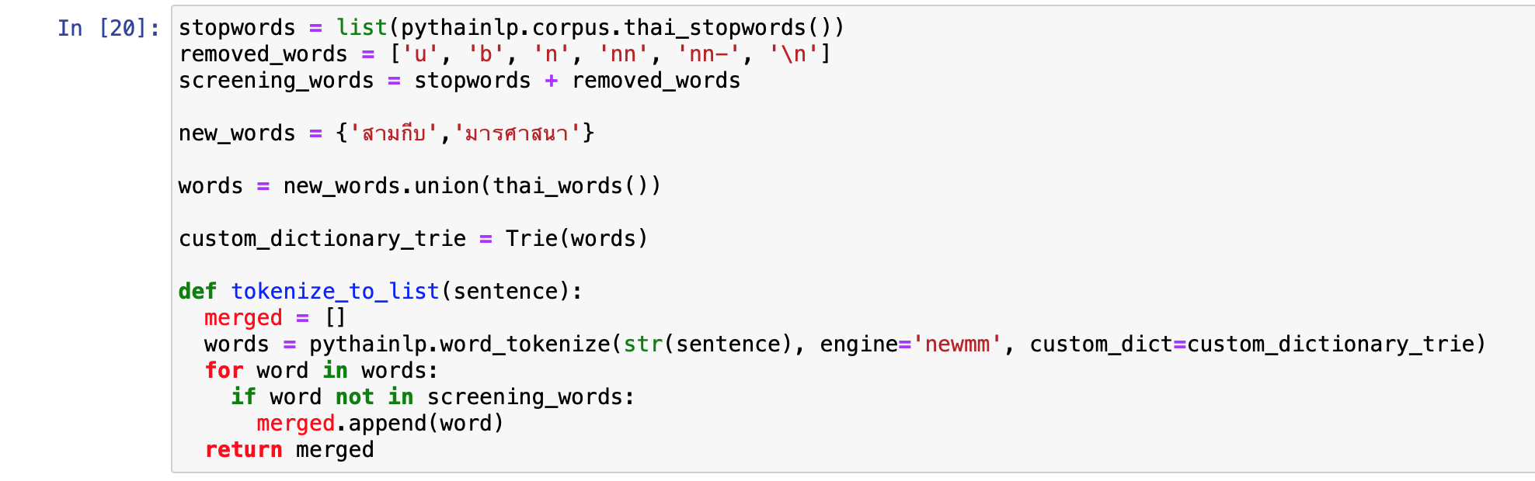
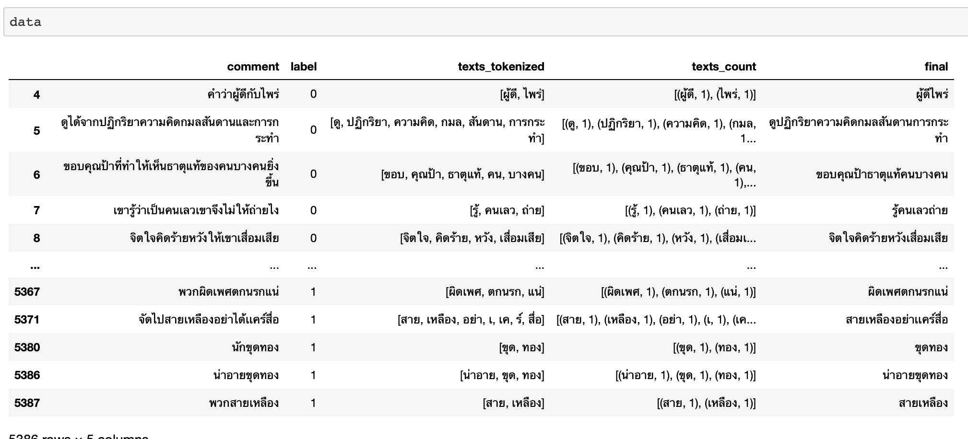
Handle Data
Model
Evaluate

Slide 10
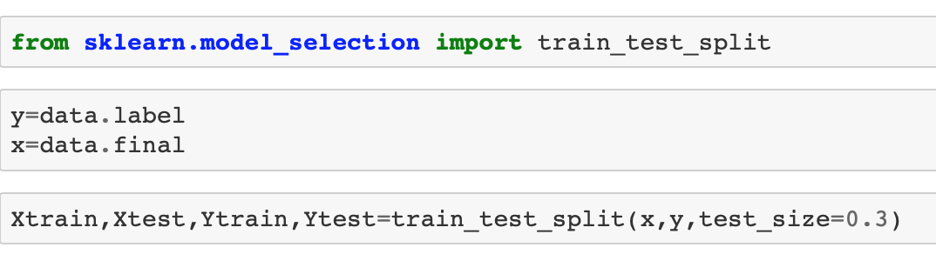
Handle Data
Model
Evaluate

Slide 11
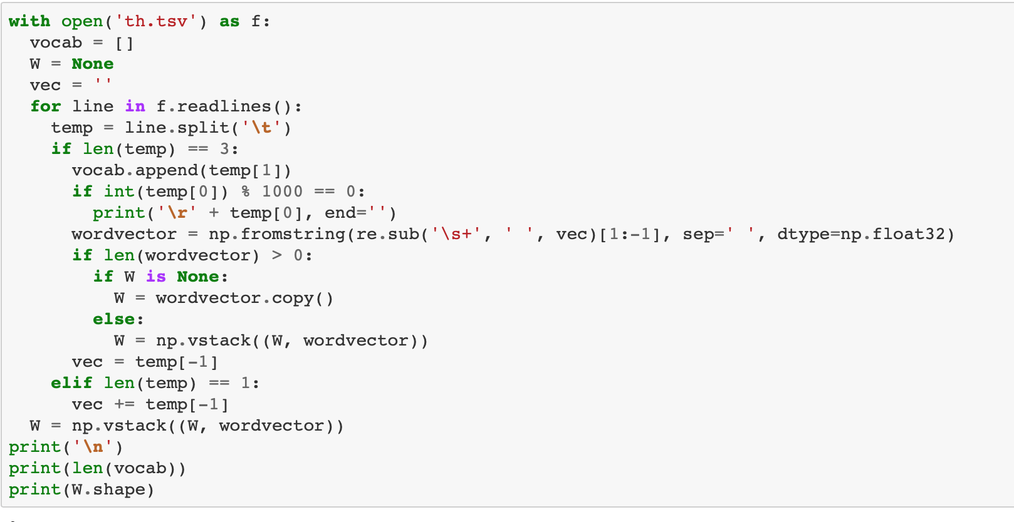
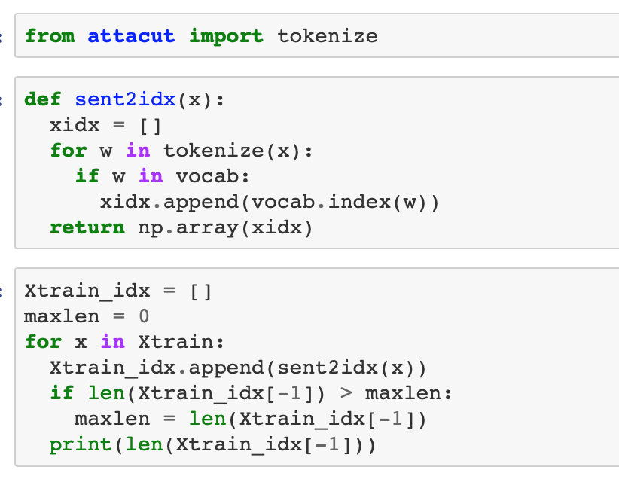
Handle Data
Model
Evaluate

Slide 12
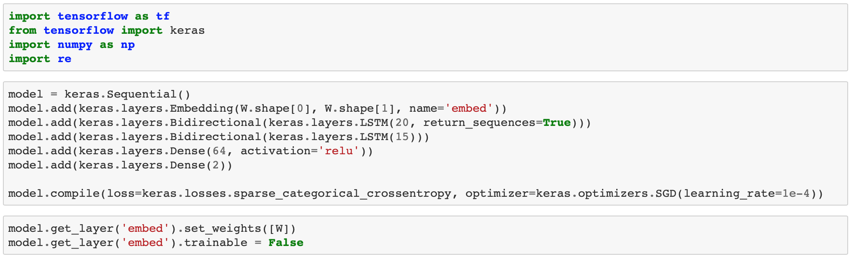
Handle Data
Model
Evaluate

Slide 13
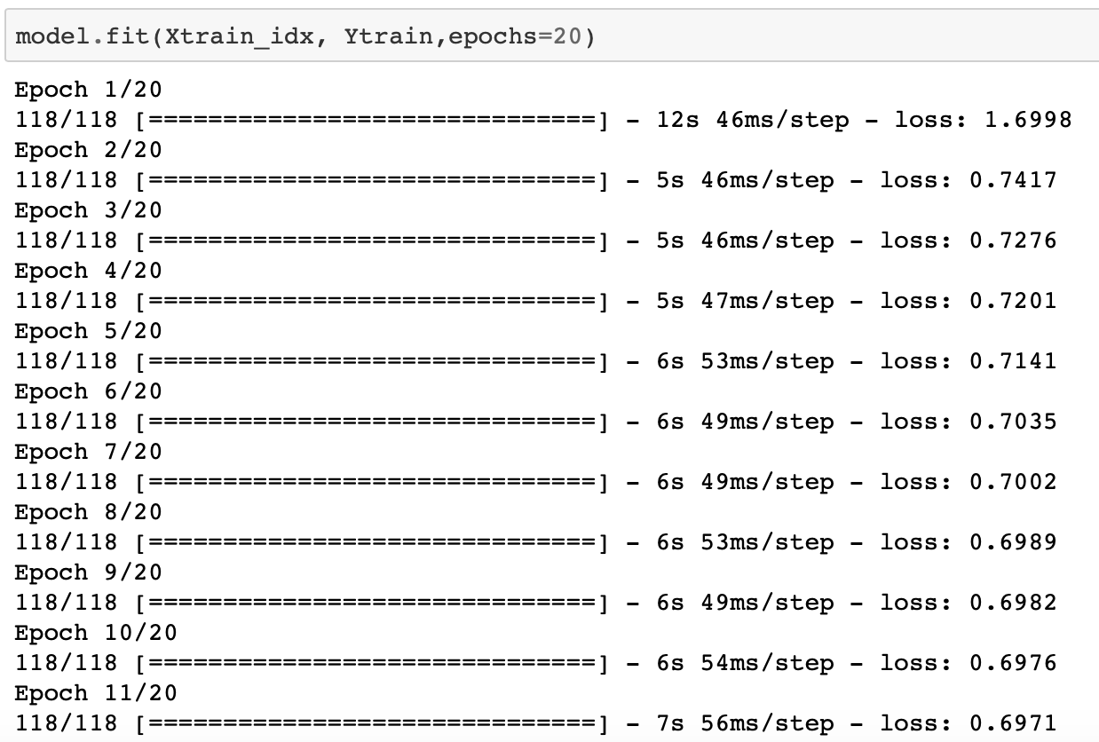
Handle Data
Model
Evaluate

Slide 14
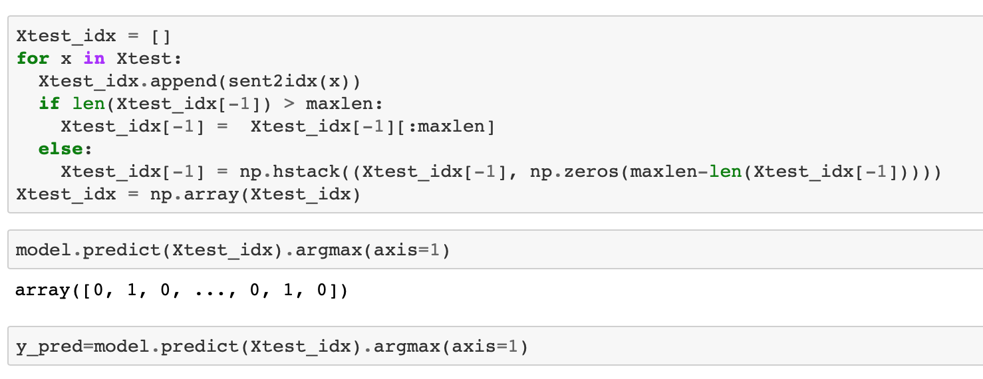
Handle Data
Model
Evaluate

Slide 15
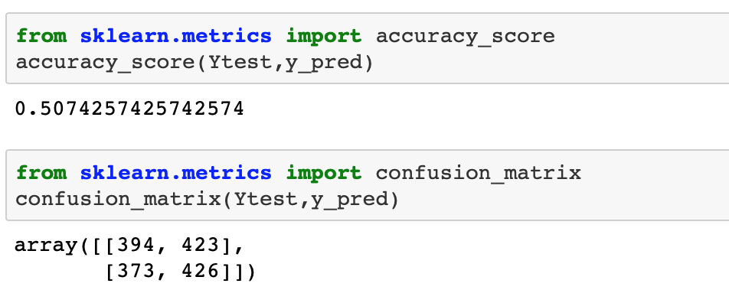
Handle Data
Model
Evaluate

Slide 16
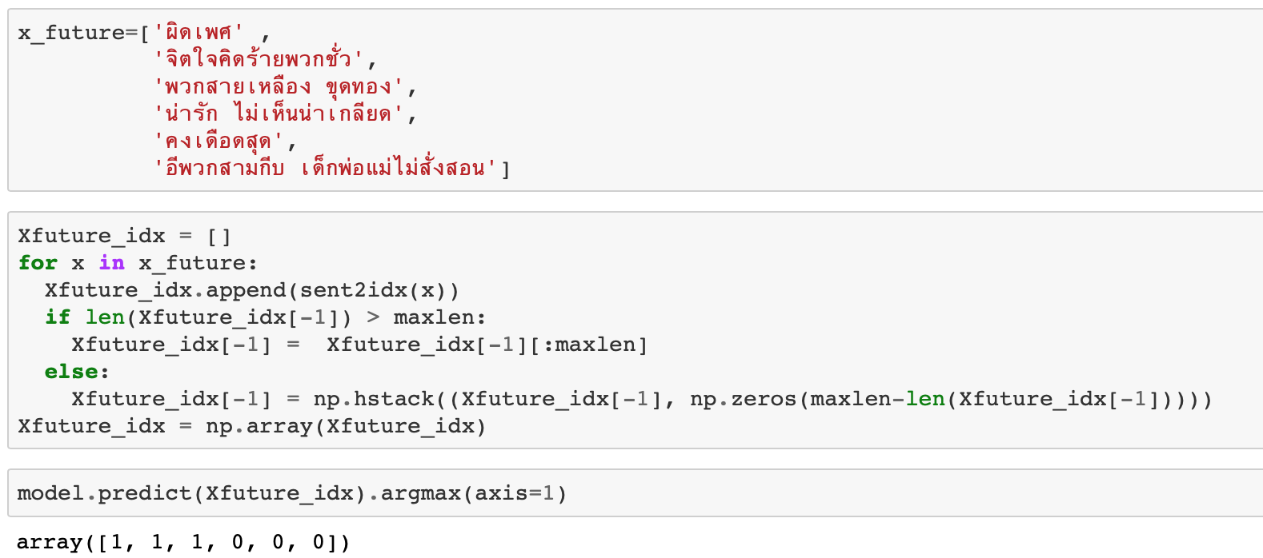
Handle Data
Model
Evaluate

Slide 17

Text Classification with BERT fine-tuning with PyTorch

Slide 18
Data Preprocessing
Word segmentation
Tokenize
Train, Validation and Test Split
Data Loader
Training model

Slide 19
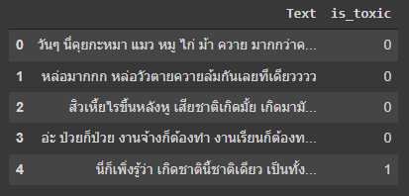
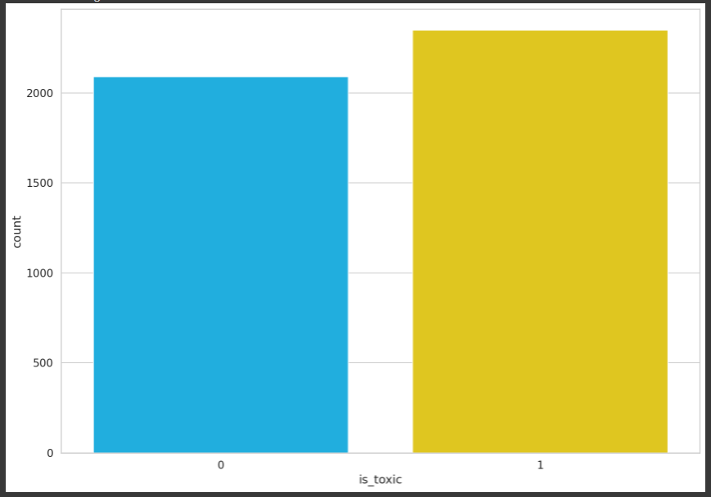
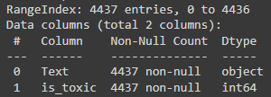
Dataset
2348
2089

Slide 20
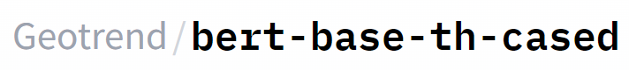
Data preprocessing : Before Tokenization
Objective
BERT Pre-training model

Slide 21
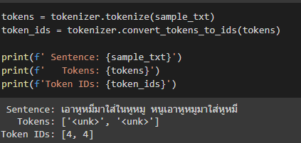
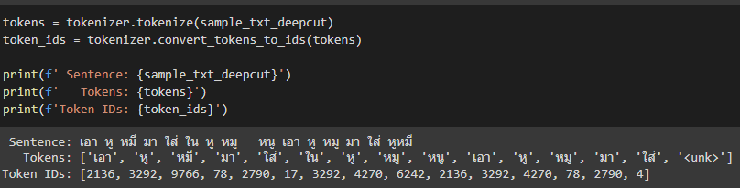
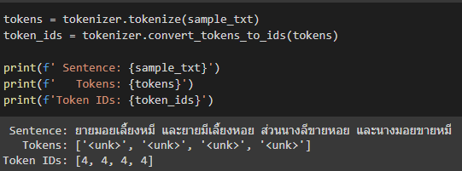
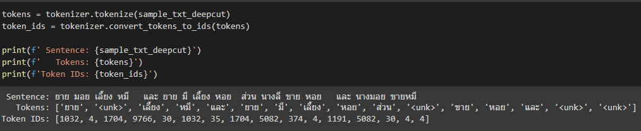
Data preprocessing : Monsoon-NLP before and after segmentation
Before word segmentation
After word segmentation

Slide 22

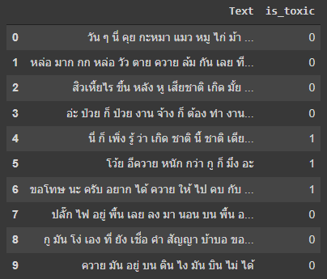
Data preprocessing
PyThaiNLP
with
Deepcut
Attacut

Slide 23
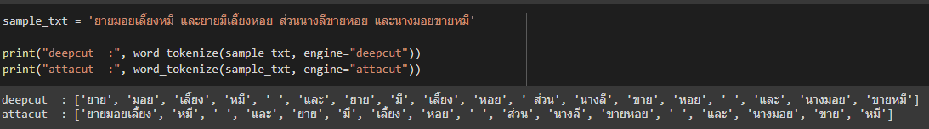
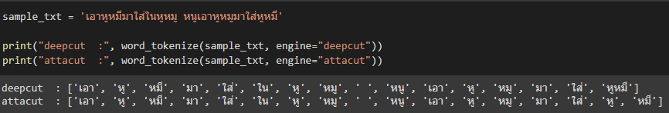
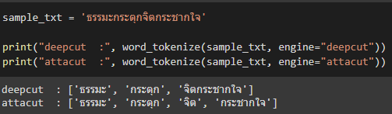
Deepcut vs Attacut

Slide 24
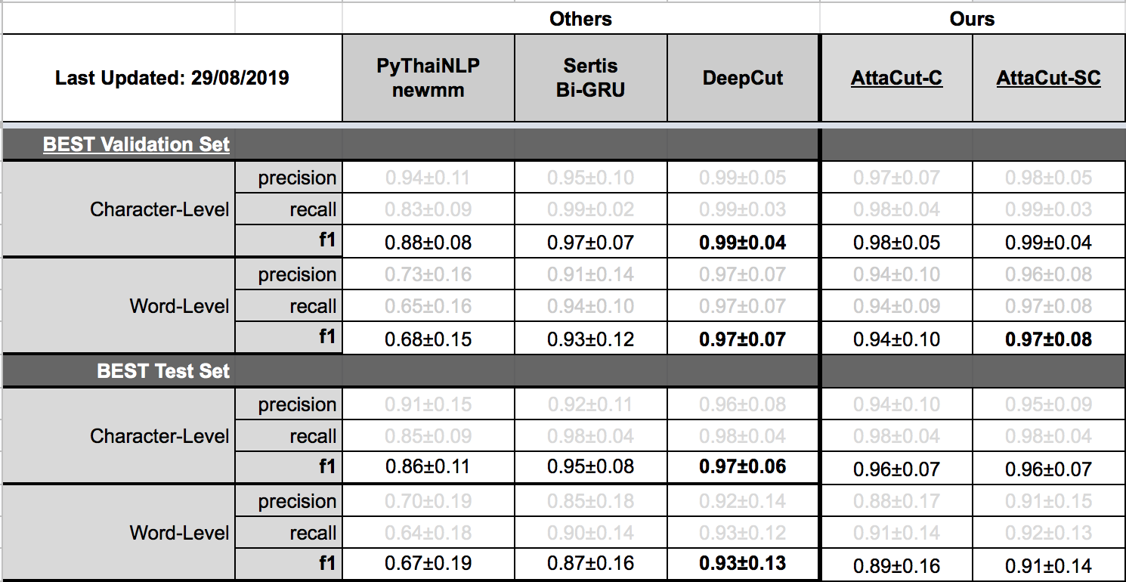
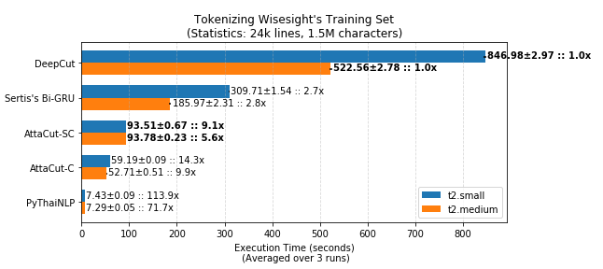
Deepcut vs Attacut

Slide 25
Tokenization
Split the sentence into tokens.
Add the special [CLS] and [SEP] tokens.
Map the tokens to their IDs.
Pad or truncate all sentences to the same length.
Create the attention masks which explicitly differentiate real tokens from [PAD] tokens.

Slide 26
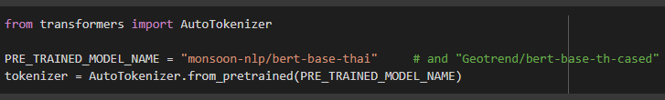

Tokenization : AutoTokenizer
BERT Pre-training model

Slide 27
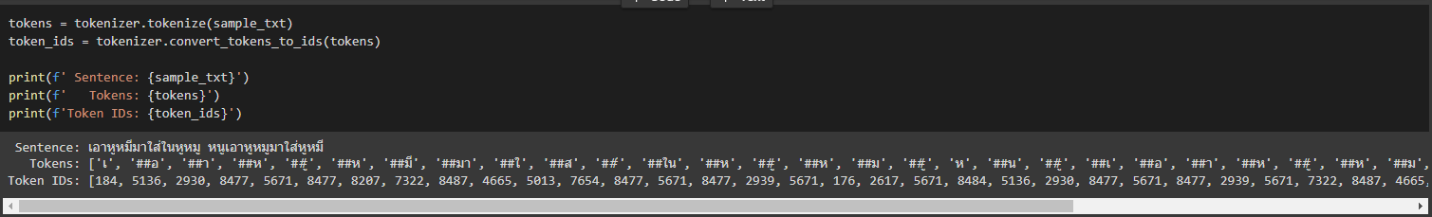
Tokenization : Geotrend vs monsoon-NLP

Slide 28
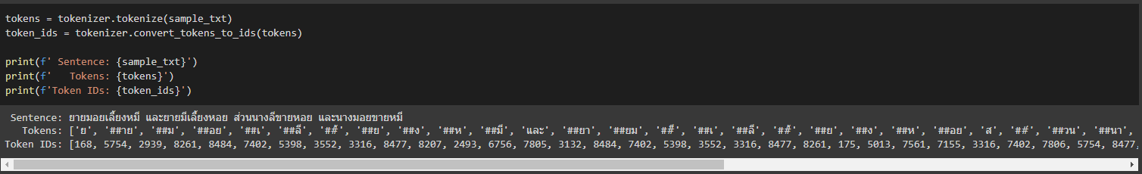
Tokenization : Geotrend vs monsoon-NLP

Slide 29
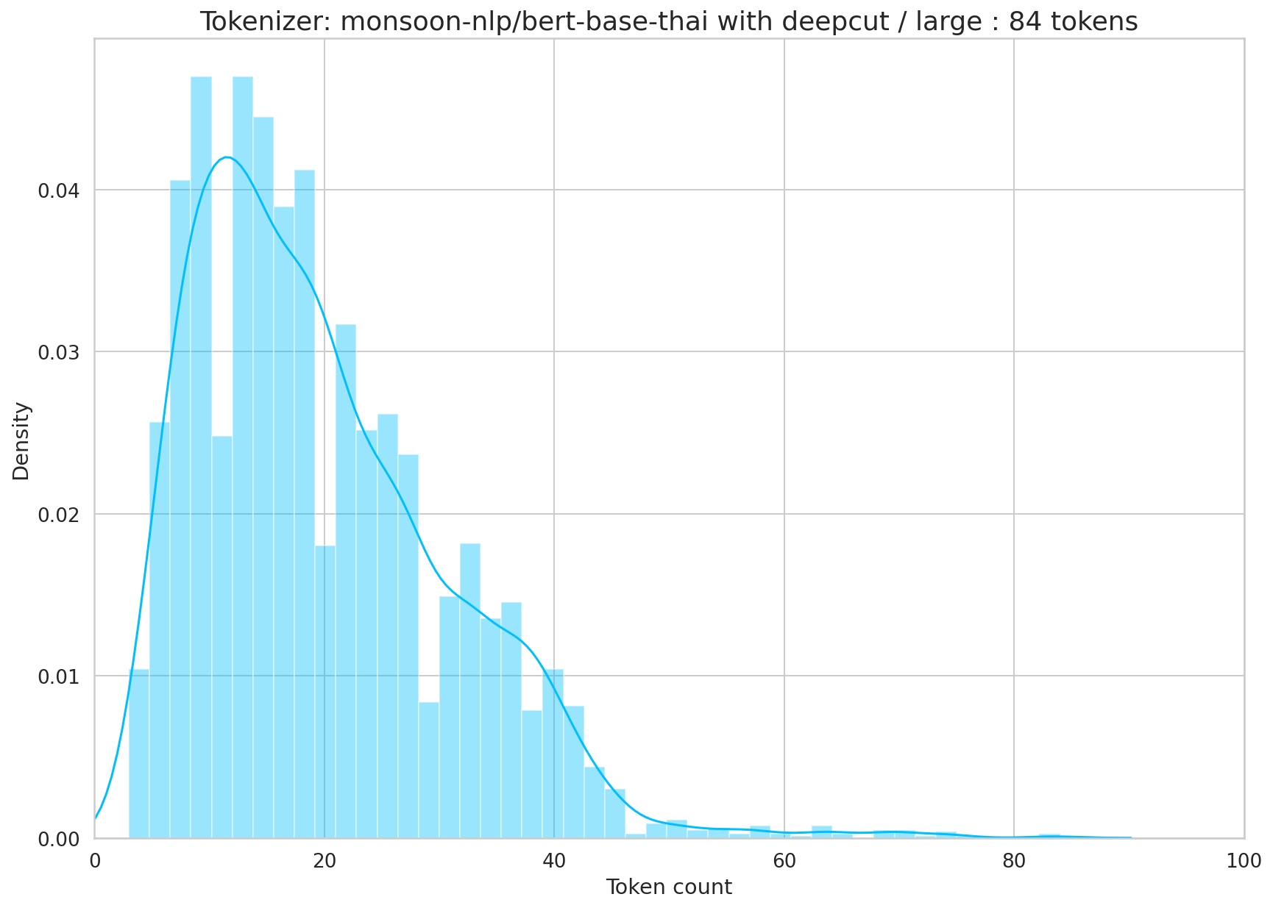
Tokenization : Monsoon-NLP choose sequence length

Slide 30
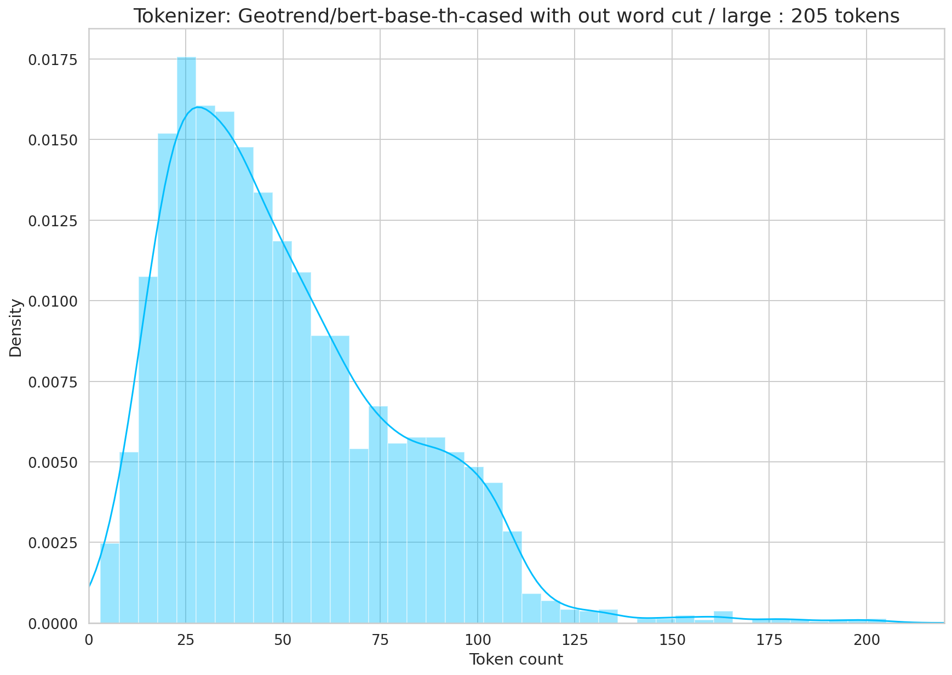
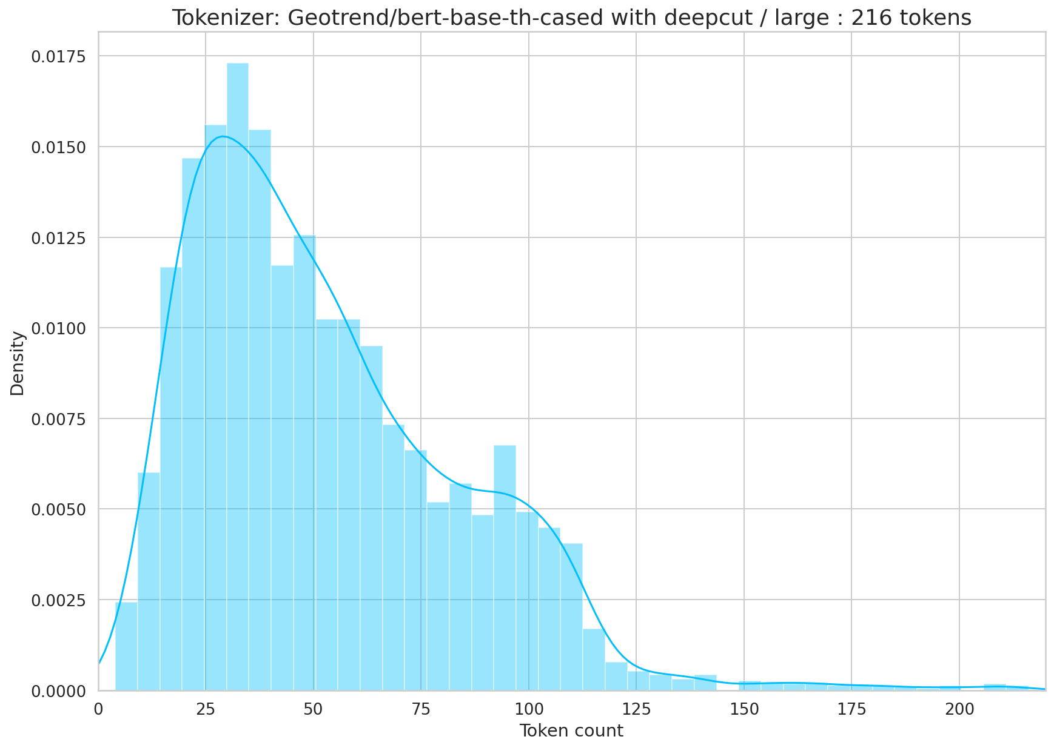
Tokenization : Geotrend choose sequence length

Slide 31
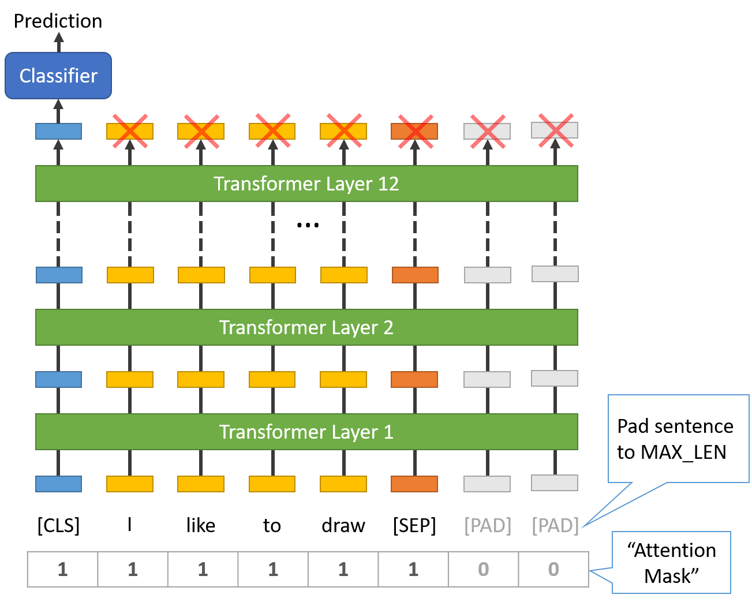
Tokenization :
Special Tokens
[SEP] – marker for ending of a sentence
[CLS] - The first token of every sequence. The final hidden state corresponding to this token is used as the aggregate sequence representation for classification tasks.
[PAD] - special token for padding
[UNK] - (unknown) token

Slide 32
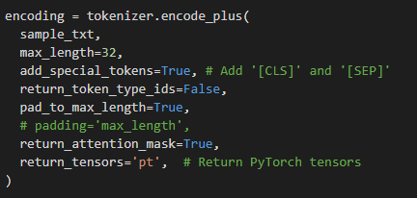
Tokenization : Tokenizer and encode methon
AutoTokenizer class from Hugging Face
encode_plus methon return tokens IDs and Attention mask
dict_keys(['input_ids’,
'attention_mask’])
Token IDs
Attention Mask

Slide 33
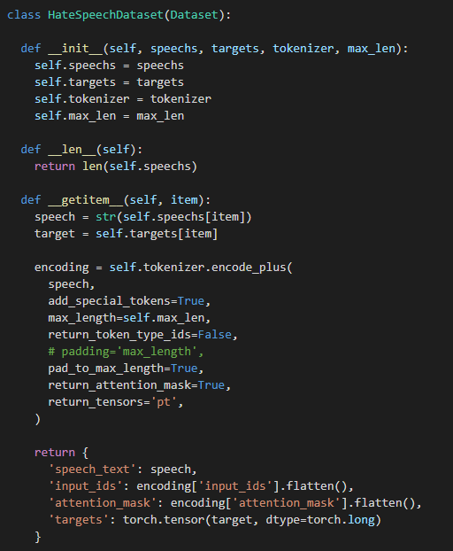
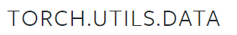
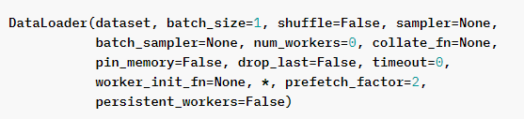
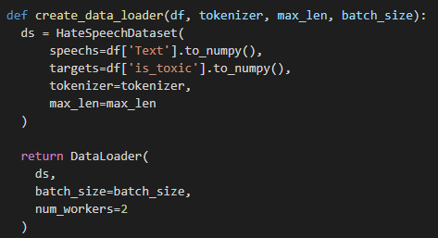
Tokenization : DataLoader from PyTorch
dict_keys([‘speech_text', 'input_ids', 'attention_mask', 'targets'])

Slide 34
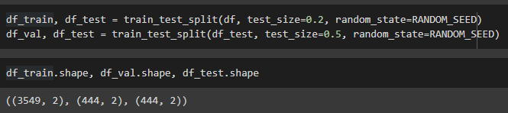
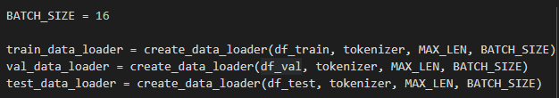
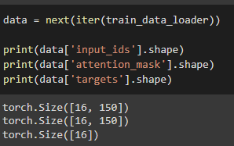
Tokenization : Split data and loader
Train, Validation and Test Split
Set batch size and create dataloaders
dict_keys([‘speech_text’,
'input_ids’,
'attention_mask’,
'targets'])
Check tensor size
For example, max length = 150

Slide 35
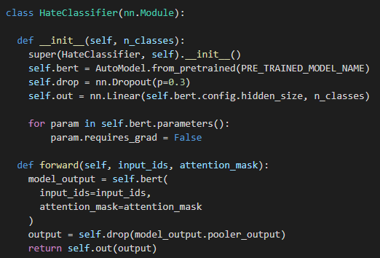
Tokenization : create classifier class
Create classifier class
Create model from BERT
pre-training model
Applies a linear transformation
Fine tuning technique: Freeze the entire architecture

Slide 36
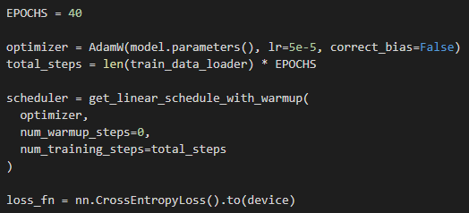
Training model

Slide 37
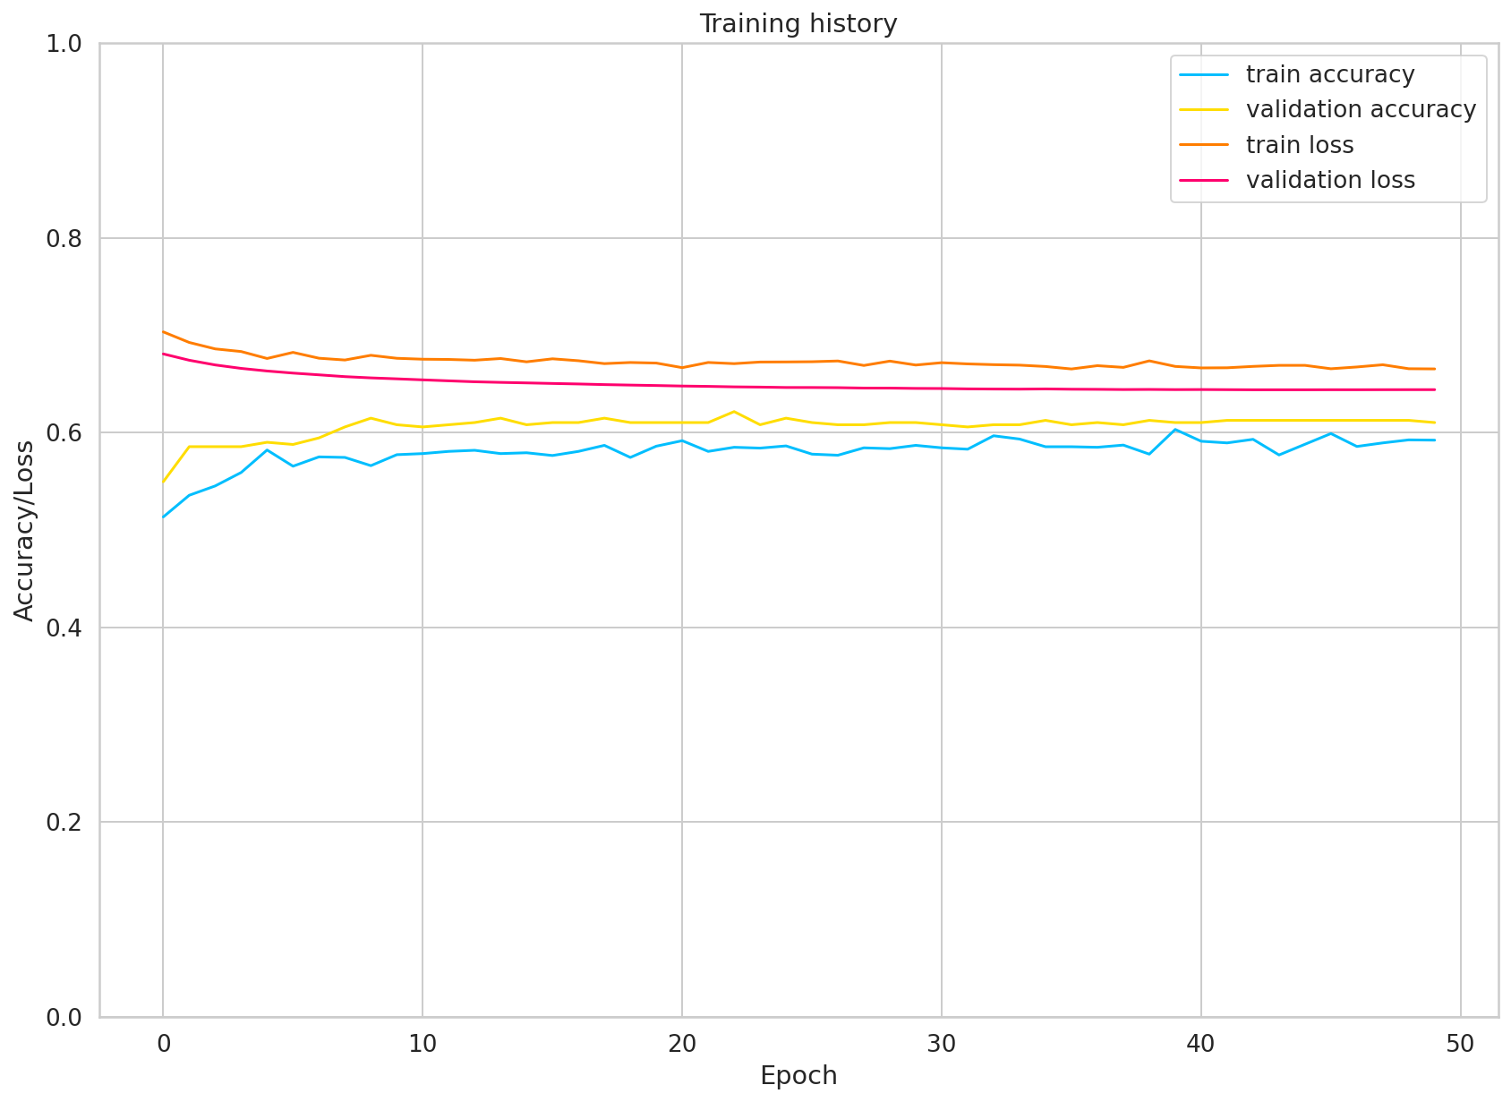
Training model : monsoon-NLP with word segmentation
Max length = 85

Slide 38
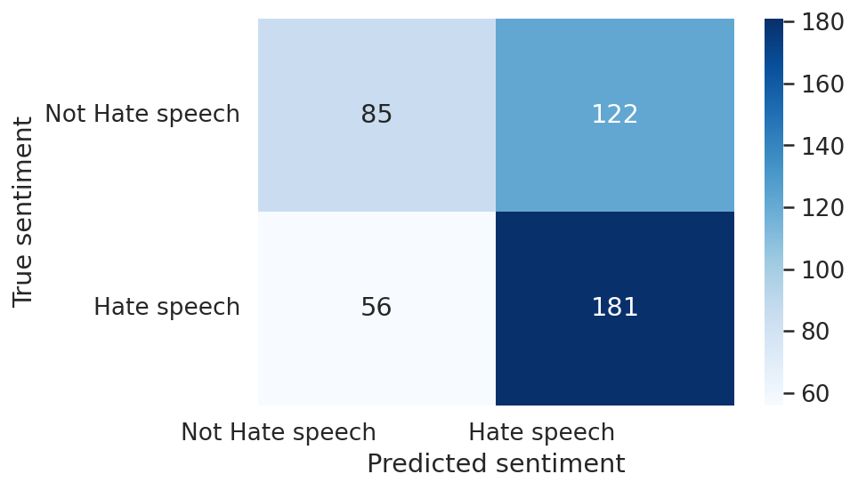
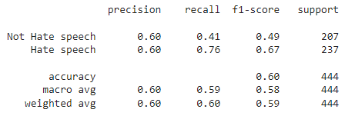
Training model : monsoon-NLP with word segmentation
Max length = 85

Slide 39
Training model : Geotrend with normal text
Max length = 210

Slide 40
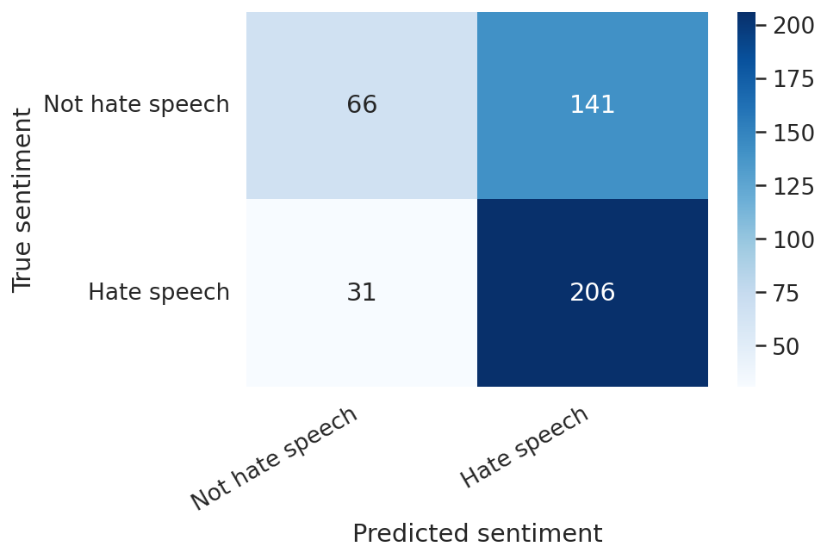

Training model : Geotrend with normal text
Max length = 210

Slide 41

Training model : Geotrend with sorting normal text
Max length = 150

Slide 42


Training model : Geotrend with sorting normal text
Max length = 150
129
79
46
186

Slide 43
Further work
Two class classification
Multi-class classification

Slide 44

Thank you

